Slide 1
Assignment-3 Presentation
BookList Database Sanzida Parvin
June 6, 2017

Slide 2

My BookList Database: Purpose
My BookList Database will store all the information about the books that I have already read
This database will help me to find out which books I have already read and expand my collection of books
It can help me to find out the exact book that I need at my free time or at a long trip.

Slide 3
My BookList Database: Information Questions
How many types of books are there in the list?
How many author’s books are there?
Stock for young readers
Which books are borrowed and lent?
Format of the books (e-copy or physical copy)

Slide 4
My BookList Database: Date-driven Decision
Which books are in my favorite list
Which books are missing
Which books are for young readers
Books of different categories

Slide 5
My BookList Database: Data Processes
During vacation time or leisure periods, the preference of the books will be easily find out
The data will give me the information about the books that I can share with my friends according to their choices.

Slide 6
My BookList Database: Subjects
Book Title
Author Name
Book Type
Price of the Book
Publisher
Ownership
Version

Slide 7
My BookList Database: Characteristics
Book Title: Name of the book
Author Name: Name of the writer
Book Type: Type of book (Novel, Story, Science fiction, Detective)
Price of the Book: How much the cost is
Publisher: Name of the publisher that published the book first
Ownership: Whether the book is self owned or borrowed or lent
Version: Physical copy or e-copy is in my collection

Slide 8
My BookList Database: Sample Data Values
Book Title: Aguner poroshmoni, Himu, Datta, Animan, Gorvodharini
Author Name: Humayun Ahmed, Sharatchandra Chattopaddhay, Muhammed Zafar Iqbal, Samaresh Majumder, Rakib Hasan
Book Type: Novel, Science Fiction, Story, Juvenile Detective
Publisher: Afsar Brothers, Annyaprokash, Gyankosh, Protik

Slide 9
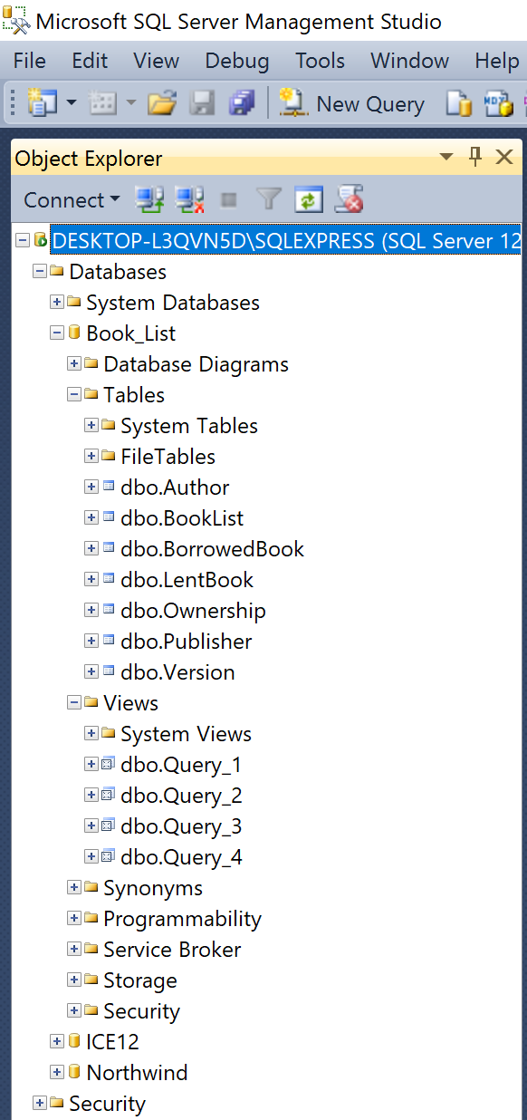
My BookList Database: SQL Server

Slide 10
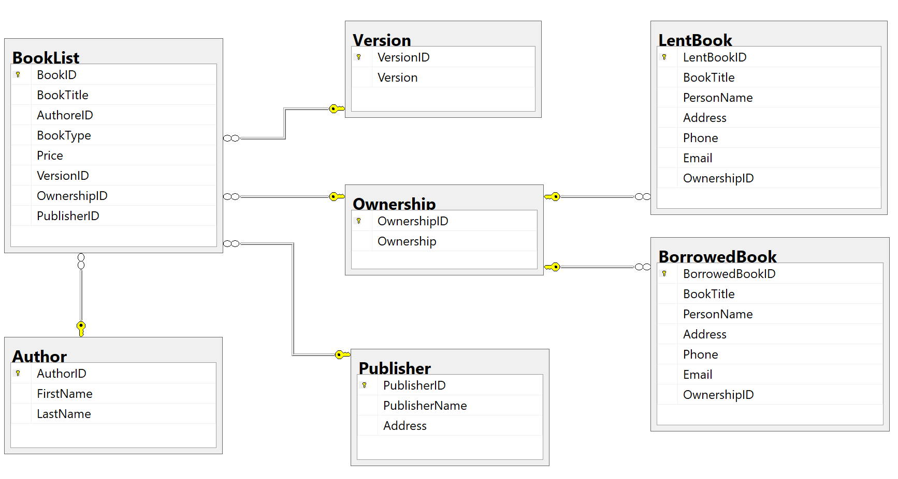
My BookList Database: Diagram

Slide 11
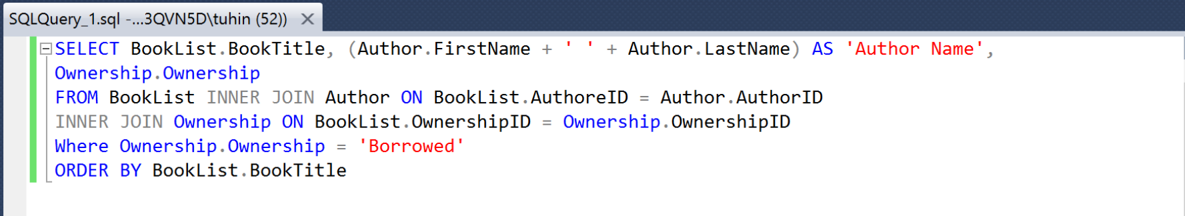
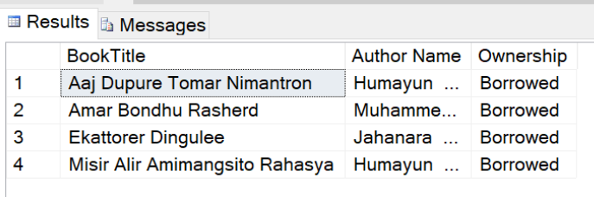
My BookList Database: Example Query
Show the title of the books with the author name that are borrowed from others.

Slide 12
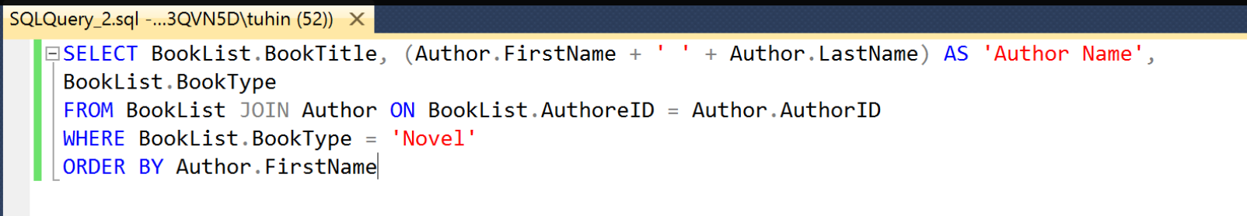
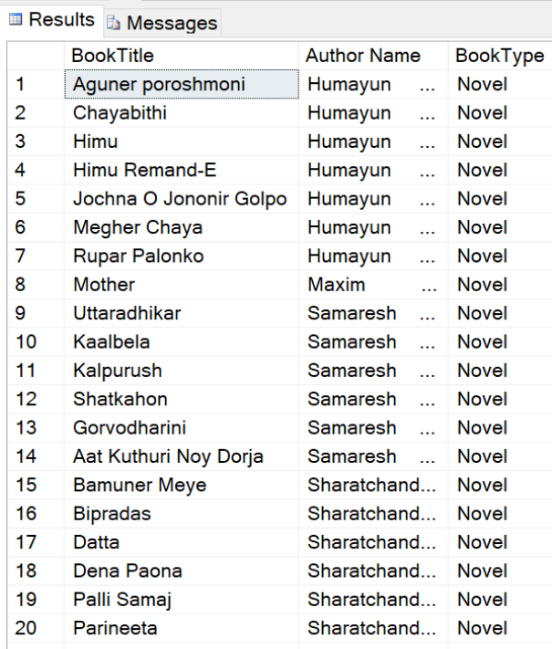
My BookList Database: Example Query
How many Novels are there in the list with the author name?

Slide 13
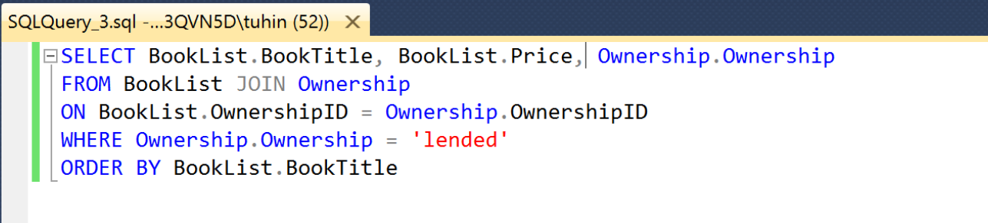
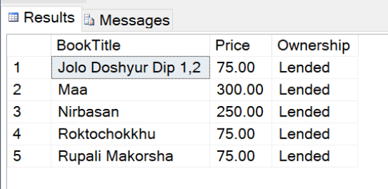
My BookList Database: Example Query
Show the name and price of the books that are lent

Slide 14
Thank You All

